Slide 1
Factors of Book Interest
Helena O’Farrow, Catherine Smith, Jackson Yaggi,
Molly Oesterling
Notes:
Helena

Slide 2
Core Message and Hypothesis
Book interest has many factors, including:
If a book has a higher number of pages, it generally gets less votes and has a lower rating.
If a book has more ratings, then the average rating will be less extreme and have a lower standard deviation.
If specific publishers publish more books, then their books published will have a higher price.
If the number of pages of a book affects the book price, then books with a higher page count will have a higher price.
If a book is published in a specific season, then its popularity and price will be higher than other months
Notes:
Catherine

Slide 3
What and Why?
Does the number of pages of a book affect the number of the votes that the books receives, and does it affect the rating?
Does the amount of votes affect the overall rating the book receives?
Do specific publishers produce more expensive books? Does the number of pages affect the price of the book?
Does the season a book is released affect interest or production in the book?
Notes:
*Describe the questions you asked, and why you asked them
Molly

Slide 4
Page Count vs. Votes
Question: How does page count affect number of votes & average rating?
Hypothesis: If a book has a higher number of pages, it generally gets less votes and has a lower rating.
Data Used: voters, page count, and rating for each book
Notes:
Describe whether you were able to answer these questions to your satisfaction, and briefly summarize your findings
Molly

Slide 5
Vote Count vs. Rating
Question: How does number of ratings impact average rating?
Hypothesis: If a book has more ratings, the average rating will be less extreme and have a lower standard deviation.
Data Used: voters and rating for each book, binned by # of voters
Notes:
CATHERINE
Questions and hypothesis
Describe whether you were able to answer these questions to your satisfaction, and briefly summarize your findings
Elaborate on the questions you asked, describing what kinds of data you needed to answer them, and where you found it

Slide 6
Publisher vs. Average Price
Question: Do specific publishers produce more expensive books?
Hypothesis: If specific publishers publish more books then their books published will have a higher price.
Data Used: publisher name, publisher book count, price in SAR, price in USD
Notes:
Helena

Slide 7
Page Count vs. Price
Question: Does the number of pages affect the price of the book?
Hypothesis: If the number of pages of a book affects the book price then books with a higher page count will have a higher price.
Data Used: page count, price in SAR, price in USD
Notes:
Helena

Slide 8
Publish Season
Question: Does the season that the book was released in make it more popular, expensive or more widely produced?
Hypothesis: If a book is published in a specific season, then its popularity and price will not be higher than other months.
Data Used: Season, publisher date, price, ratings.
Notes:
Jackson

Slide 9
Data Exploration
Process of Finding Data
Kaggle.com
Notes:
Jackson

Slide 10
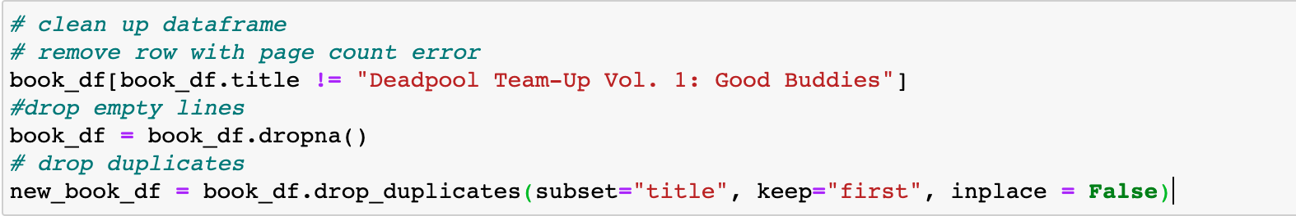
Cleanup Process
Removed row with page count error
Drop N/A
Drop Duplicates
Notes:
Catherine

Slide 11
Unanticipated Insights and Problems
Searching for a dataset with quantitative vs qualitative data was difficult
Large dateset doesn’t mean large amount of useable data
Some lines of data are inaccurate/ contain errors
Notes:
Helena

Slide 12
Data Analysis

Slide 13
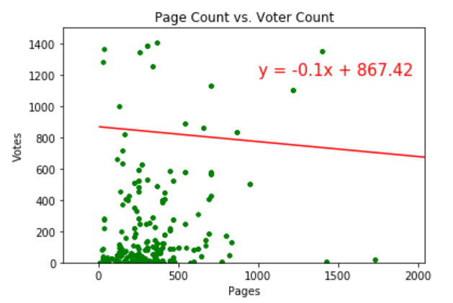
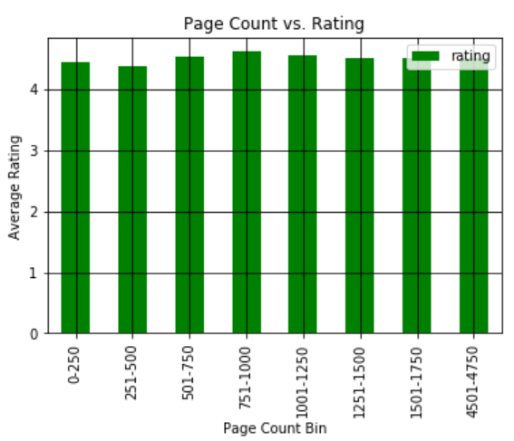
Page Count vs. Votes
Notes:
Describe whether you were able to answer these questions to your satisfaction, and briefly summarize your findings
Molly

Slide 14
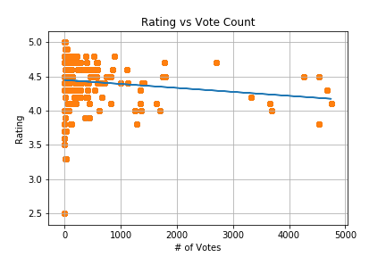
Vote Count vs. Rating
Findings:
As expected, ratings trended towards a more neutral outcome as # of votes increased.
Notes:
CATHERINE
Describe whether you were able to answer these questions to your satisfaction, and briefly summarize your findings
Elaborate on the questions you asked, describing what kinds of data you needed to answer them, and where you found it

Slide 15
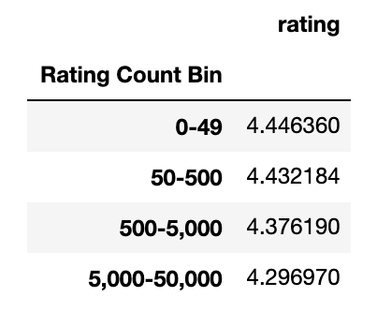
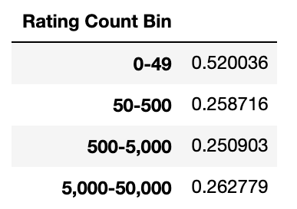
Average Rating Binned
Standard Deviation Binned
Ratings trended towards a more neutral outcome by bin as # of votes increased.
As expected, ratings had a higher stdev (less normally distributed) when there were fewer votes.
Surprised by similarity of stdev in the last 3 bins
Notes:
CATHERINE

Slide 16
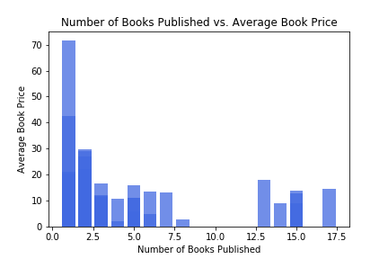
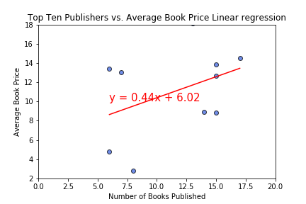
Number of Books vs. Average Price
Notes:
HELENA
Number of books published doesn’t have a consistent correlation with average book price
It seems as though most of the publishers from our list only had one published book
Some of the books were not strictly “read for fun” kind of books. There were many books in the dataset that were textbooks. This may describe why the price was so high for just one book.
For the second plot, it breaks the list of publishers down to only the top ten publishers that published the most books. With this data, you can see that there is more of a correlation between publishers and book price but it is very slight.
You can also see that there are many outliers that don’t follow the linear regression line. Therefore, it could suggest that the data may not have an accurate representation of all books.

Slide 17
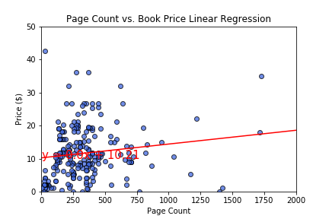
Page Count vs. Price
Data shows that there was a very slight correlation
Not enough of a correlation to be relevant
Notes:
HELENA

Slide 18
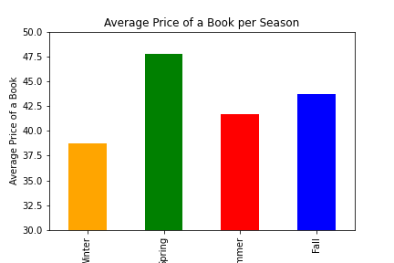
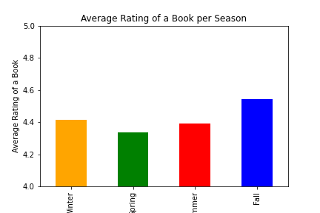
Publish Season
Notes:
JACKSON

Slide 19
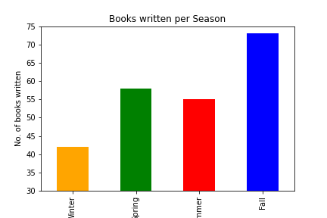
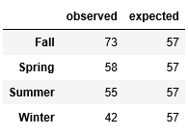
Expected vs. Observed
Null: There is no relationship between the two variables
Chi-square test
Critical value was 7.81
Received a score of 8.53
Notes:
JACKSON

Slide 20
Discussion
Notes:
Each person puts their own discussion.
HELENA - For my two questions, the data did not show a significant correlation between the amount of books a publisher published and average price or page count vs price. For this reason, I can not say that I was able to “prove” my original hypothesis. My new conclusion is that the amount of books a publisher publishes and the number of pages a book has are not large factors that play into the actual price of the books. Although I can suggest this based on my results, there may be limitations to this finding because the dataset only had a small population of total books published worldwide.

Slide 21
Difficulties and Additional Questions
Combining everyone’s notebook proved to have some difficulties. We had to adjust variables and fix a TypeError
Is there a publisher that publishes most books or most popular books?
How would the findings have been affected if we had not cleaned up the data beforehand?
Was there a reasoning behind the books that were chosen for the dataset?
Notes:
JACKSON

Slide 22
Questions?

